Slide 1


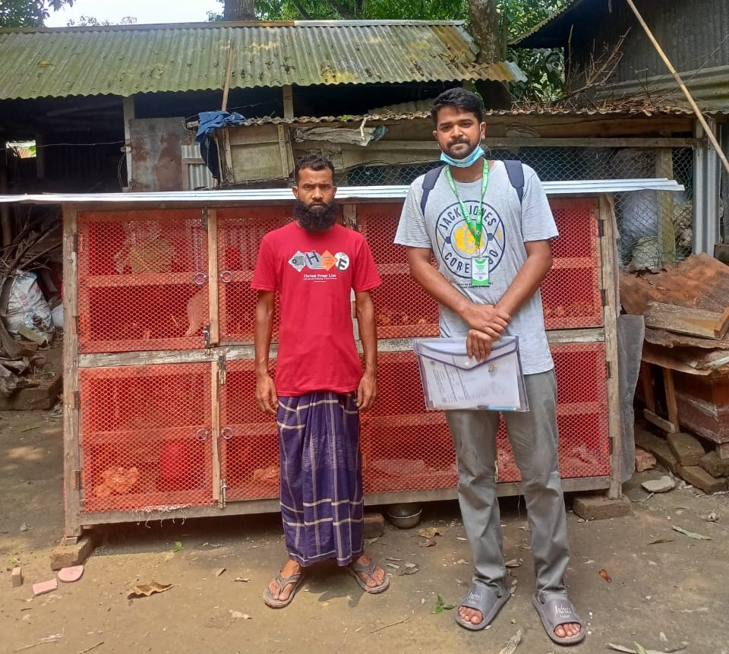



POSTER TITLE: Household Level Data Collection and Assessment of Livestock and Poultry Related Parameter in Sirajganj Sadar Upazila
AH5002: Household Level Field Work
Siam Khan
ID No: 2003165, Registration No:51576
AH5002: Household Level Field Work
B.Sc. A.H. (Hons.) Level 5 Semester 1 January-June/2024
Supervisor: Professor Dr. Mohammad Shamsul Alam Bhuiyan
INTRODUCTION
RESULTS/ KEY FINDINGS
RESULTS/ KEY FINDINGS
The Faculty of Animal Husbandry at Bangladesh Agricultural University (BAU), established in 1962, has been a pioneer in agricultural education in Bangladesh. To provide practical, hands-on experience to students, the faculty introduced internship semesters in 1999. These internships aim to bridge the gap between theoretical knowledge and real-world practices.
As part of the 21st internship batch, I undertook my internship at the Upazila Livestock Office and Veterinary Hospital in Sirajganj Sadar, Sirajganj. This fieldwork, conducted from May 25, 2025, involved collecting data from 100 rural households. The initiative was designed to explore the present scenario of livestock production, management practices, and disease prevalence at the grassroots level.
This experience also focused on enhancing communication, monitoring, and evaluation skills, critical for effective livestock extension services. Through this work, I aimed to contribute to the understanding of livestock farming challenges and provide data for future policy-making, addressing key issues in livestock and poultry management in rural Bangladesh.
The Faculty of Animal Husbandry at Bangladesh Agricultural University (BAU), established in 1962, has been a pioneer in agricultural education in Bangladesh. To provide practical, hands-on experience to students, the faculty introduced internship semesters in 1999. These internships aim to bridge the gap between theoretical knowledge and real-world practices.
This study, Conducted under the AH5002 course I took my internship at the Upazila Livestock Office and Veterinary Hospital in Sirajganj Sadar, Sirajganj. This fieldwork, conducted from May 25, 2025, involved collecting data from 100 rural households . Using a structured questionnaire , it assessed species and breed diversity, production and reproduction metrics , feeding and housing systems , health management , marketing and farmer challenges , key findings including data on milk yield , egg production and reproduction performance.
This experience also focused on enhancing communication, monitoring, and evaluation skills, critical for effective livestock extension services.
Parameter | Deshi cattle | HF cross cattle
Age at first calving(M) | 30-36 | 20-24
Lactation period(day) | 210-230 | 270-290
Litter size | 1 | 1
Post partum heat period(M) | 3-5 | 2-3
Calving interval(M) | 13-15 | 12-13
Milk yield(L)(avg) | 1-1.5 | 5-6
Birth Weight(kg) | 18-20 | 30-32
Parameter | Chicken | Duck | Pigeon
Age at first laying(Month) | 6-7 | 7-8 | 5
Avg. clutch size and pause size (No.) | 10-15 egg 30-60 days | 8-15 egg 40-65 days | 2 eggs 10-12 days
Egg Size/ Weight (Gram) | 35-40 | 55-60 | 13-15
OBJECTIVES
Figure: Production Parameter of Livestock & Poultry
To catalog the household-level livestock and poultry Related parameters
To examine the production , reproduction, breeding management, feeding, housing and healthcare
Asses the use of local and commercial feed resources by farmers
CONCLUSION
Analysis the annual profit and socioeconomic impact of livestock and poultry farming in household level
Evaluate the effectiveness of existing extension services and support the marginal farmers
Identify gaps and offer actionable recommendations for enhancement
This household-level study reveals that livestock and poultry production in Sirajganj Sadar Upazila relies heavily on traditional methods with limited access to modern breeding, management and veterinary service. Many issues such as insufficient training, inadequate veterinary services, high feed costs, and limited disease prevention measures obstruct progress. Addressing these challenges through enhanced extension support, widespread vaccination programs, affordable artificial insemination services, and better farmer training can revolutionize rural livestock farming. Those can ensure sustainable farming practices, boost productivity, and contribute significantly to meeting the protein demand of the country.
METHODOLOGY
Study Area (Sirajganj Sadar)
Structured Questionnaire
Techniques of data Collection
ACKNOWLEDGEMENT
Sampling Method
I Would Like To Express My Heartfelt Gratitude To:
Data Recording
1.Bangladesh Agricultural University, Mymensingh
2.Department of Livestock Service
3.Faculty of Animal Husbandry
4.Internship Management Cell
5.Dean,Facult of Animal Husbandry
6.Supervisors and Guiding Professor
7.Upazila Livestock Officer
8.Veterinary Surgeon
9.Office staffs
10.Farm Workers
Data Entry
Data Analysis

